Slide 1
Deep Predictive Learning in the Neocortex and Pulvinar
Randall C. O’Reilly
University of Colorado Boulder
University of California Davis
eCortex, Inc

Slide 2
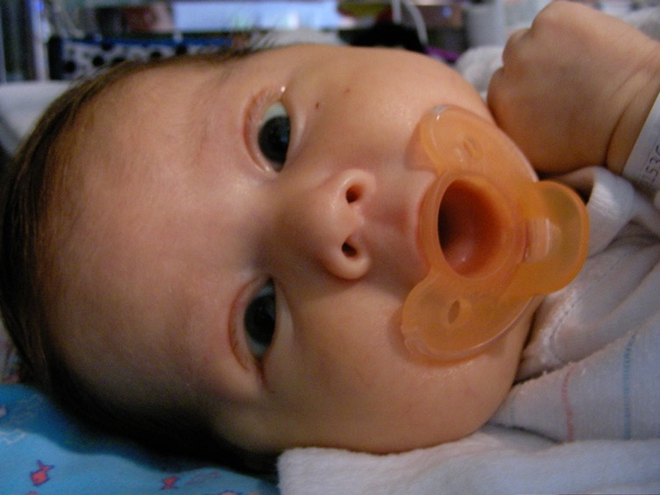
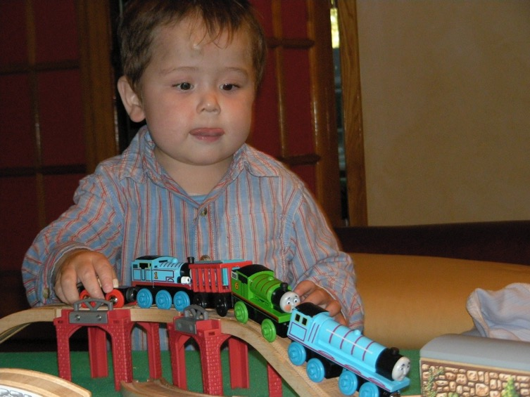
The Mystery of (Knowledge) Development
The first ~6 months: passive, but intent, staring at the world moving by..
And yet, so much is learned: the foundation for everything we know..
How does this happen!?

Slide 3
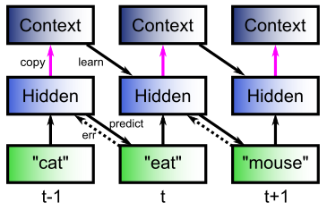
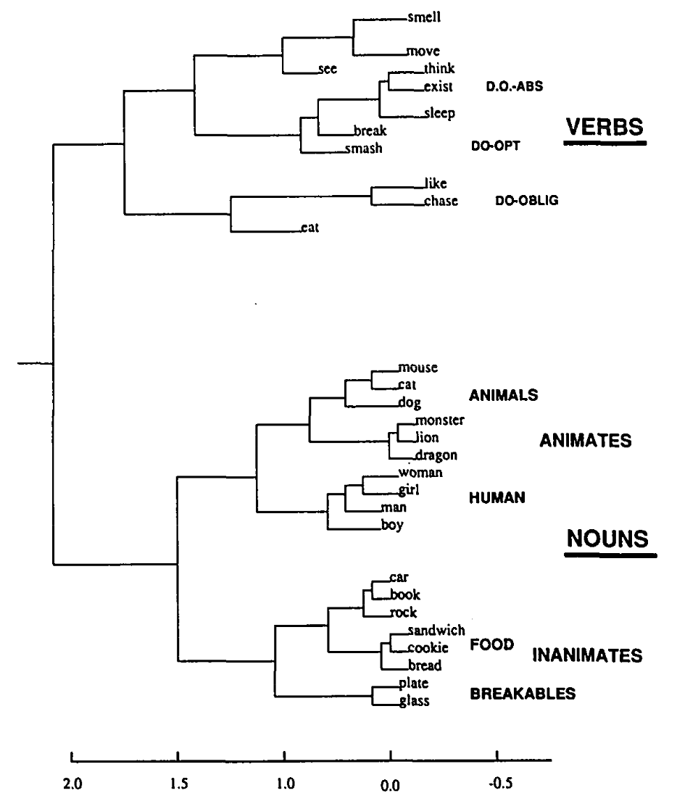
The Predictive Bootstrap (Elman 1990; Elman, Bates, et al. 1996)
Learning to predict words induces verb vs noun category representations in hidden layer of SRN
The future is free!
If you can predict it, you know it!

Slide 4
Conclusions
Peculiar features of connectivity between cortex and thalamus, and interesting developmental wiring changes, support form of predictive learning (many diffs from Friston and others).
Computational model shows that predictive learning from raw visual “movies” self-organizes abstract categorical object representations (based on shape, not texture!)
EEG test of model shows predictive learning signals in theta and alpha bands over visual areas.
Implicit sequence learning / statistical learning => predictive learning!
The future: predictive learning of goals!

Slide 5
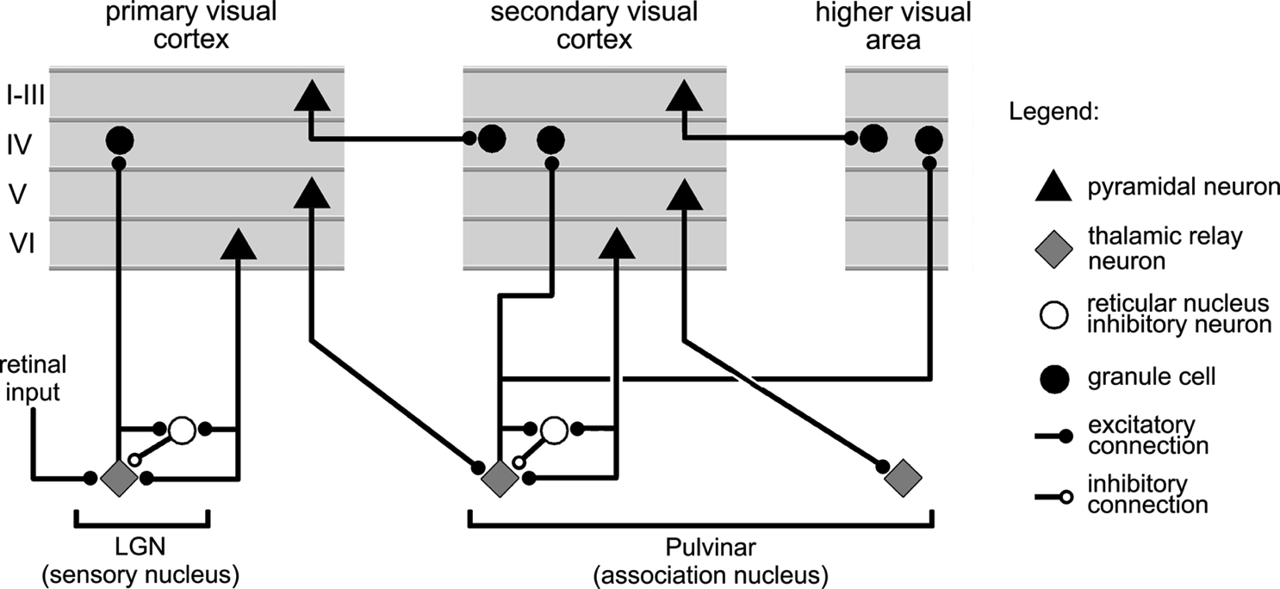
Thalamocortical Loop Biology (Sherman & Guillery, 2006)
5IB
FF
Driver
Weak
FB
What is function of strong feedforward driver vs. weaker feedback pathway?

Slide 6
The Pulvinar = Projection Screen (c.f. Mumford, 1991 “blackboard”)
Pulvinar receives connections from all over visual cortex
and projects back out to these same areas
Two qualitative inputs:
1. Few strong driving inputs – feedforward
2. Many weaker feedback “modulatory” connections
Pulvinar!

Slide 7
Central Hypotheses
Error-driven learning over time from diff between prediction and what happens next
Prediction – outcome cycle = 100ms = 10hz = alpha
Cortical deep layers drive prediction on Pulvinar
Layer 6CT neurons drive prediction
5IB (alpha burst) from lower layers drive outcome
Error is temporal diff, broadcast fm pulvinar
Local temporal-diff learning throughout cortex

Slide 8
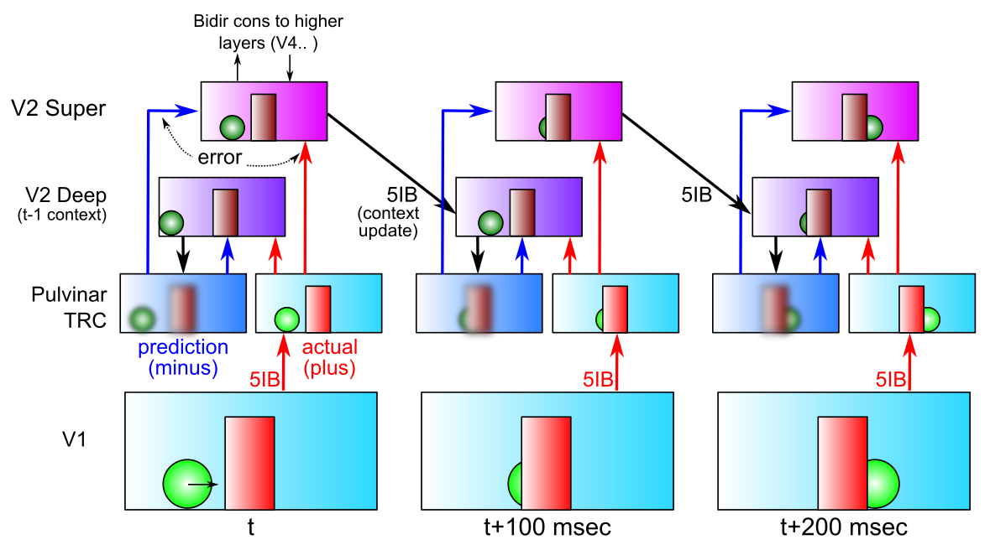
DeepLeabra Predictive Learning
- Deep neocortical layers generate prediction using prior context (SRN)
- Activate Pulvinar with prediction in minus phase (first 75 msec)
- V1 5IB (intrinsic bursting, at alpha) drives plus phase (last 25 msec)
- Error-driven learning on temporal difference improves prediction

Slide 9
DeepLeabra Problems and Solns
- Always represent / process the current input: superficial layers
- Yet force system to make a true prediction (“about the future”):
deep layers, cutoff from current input, rely on prior context
- Error signal available to everyone, everywhere: temporal difference
much simpler than explicit error-coding; integrates all forms of error

Slide 10
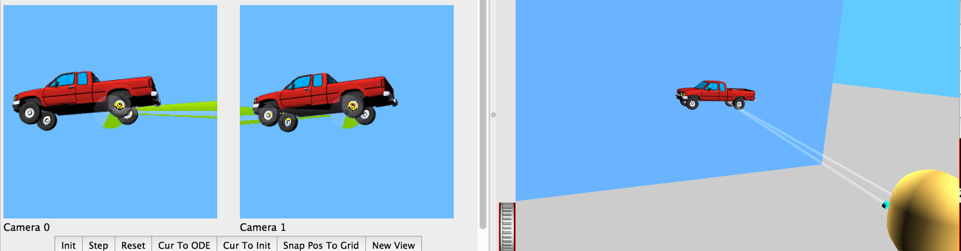
Predictive Vision
Desirable difficulty of predictive learning:
physics, optics, “core knowledge”
No need for hand labeled data (the future is free!)

Slide 11
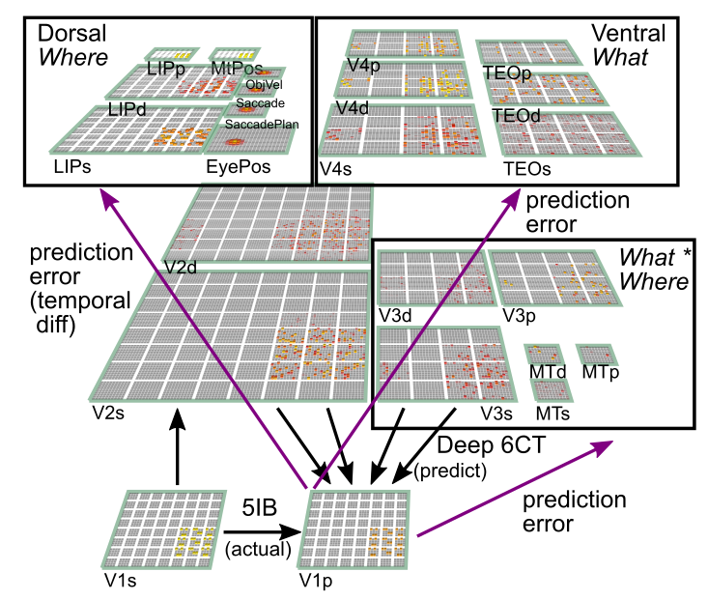
What-Where-Integration Model (O’Reilly, Wyatte & Rohrlich, under revision)
3 Separable pathways
Where develops first using location blobs
What*Where needed for binding two streams
What takes longest, requires other errors to be factored out first
Pulvinar is shared projection screen for predictions
Predicts next visual input at 100 msec (10hz, alpha) frequency
Pulvinar

Slide 12
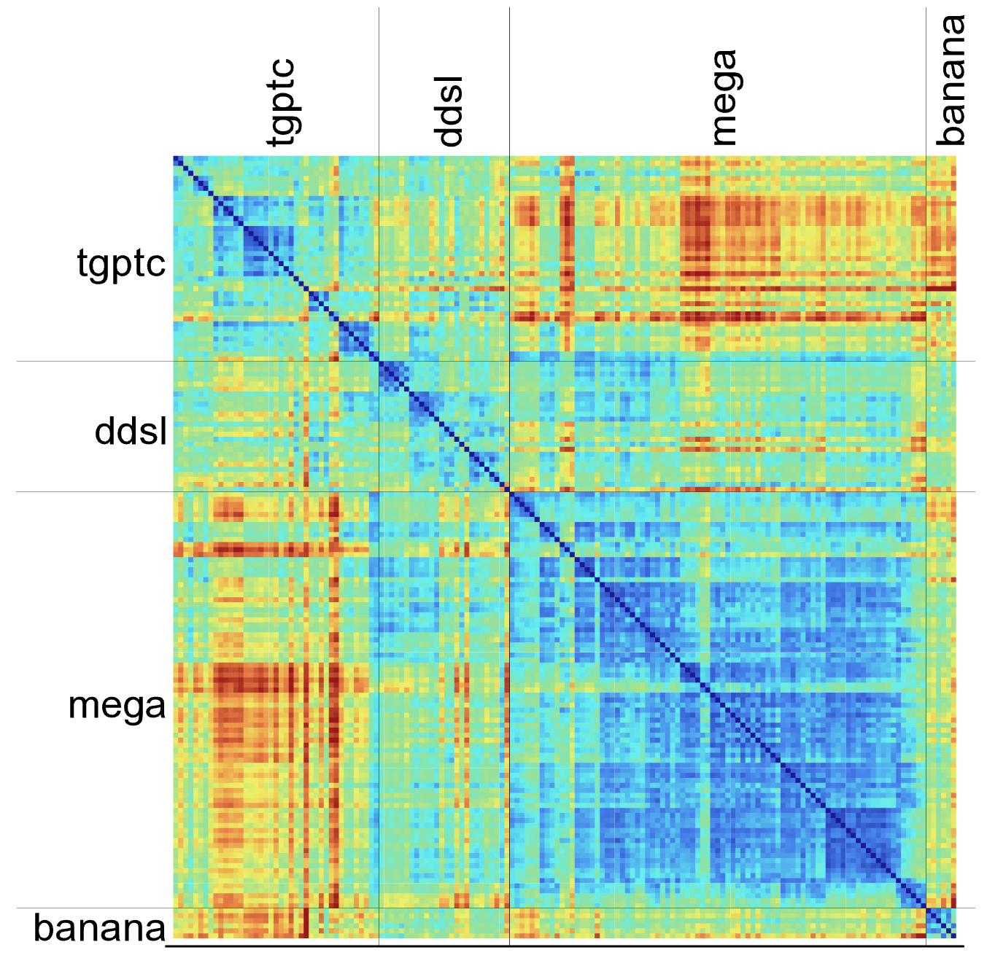
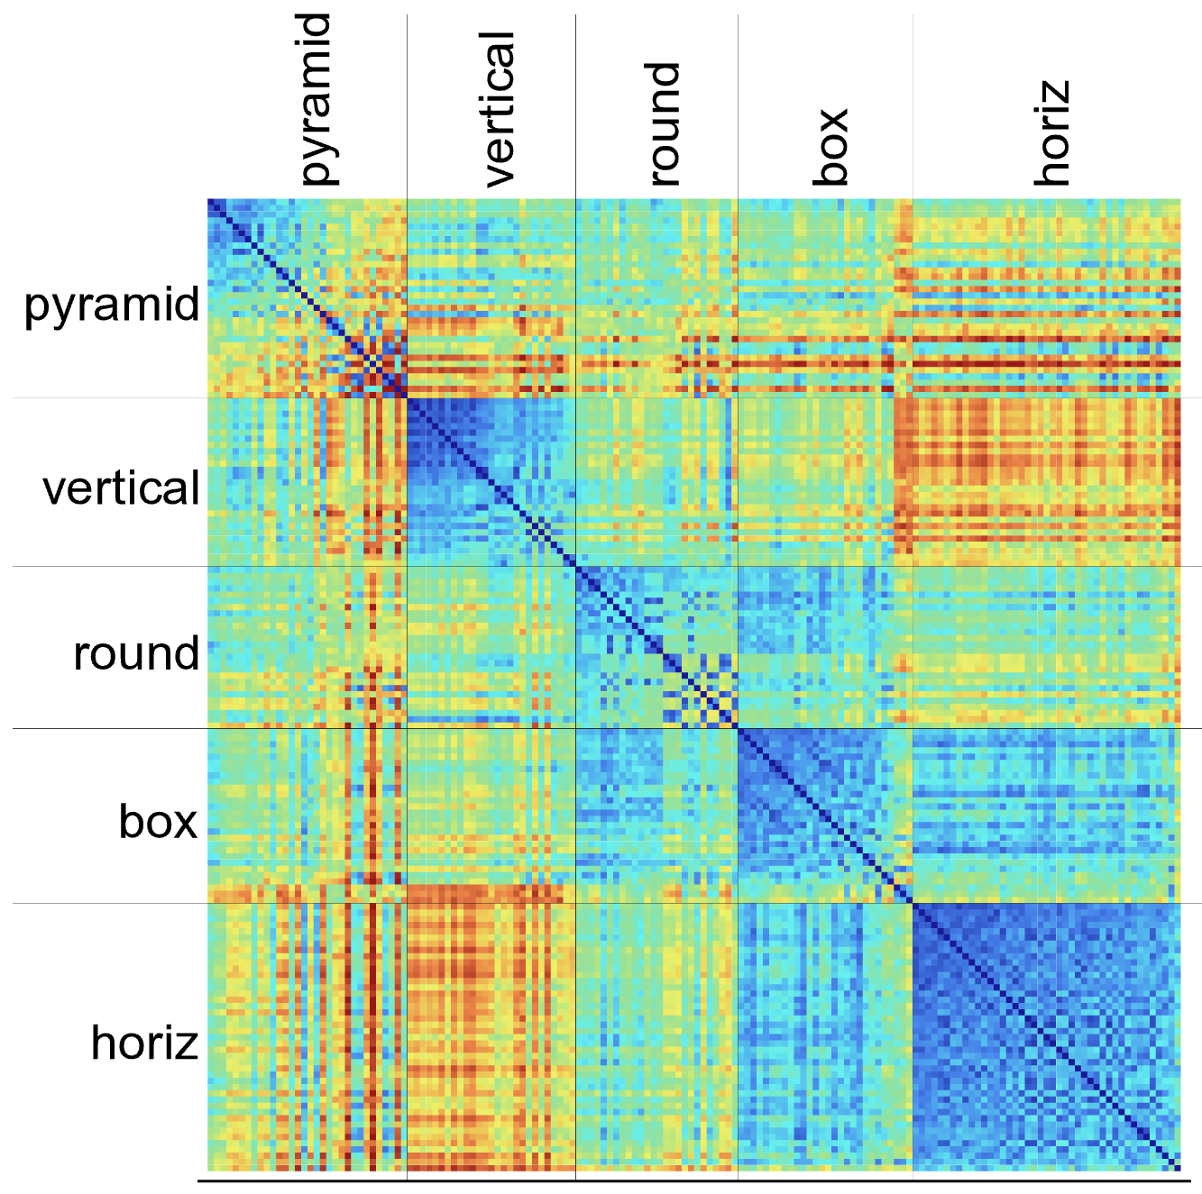
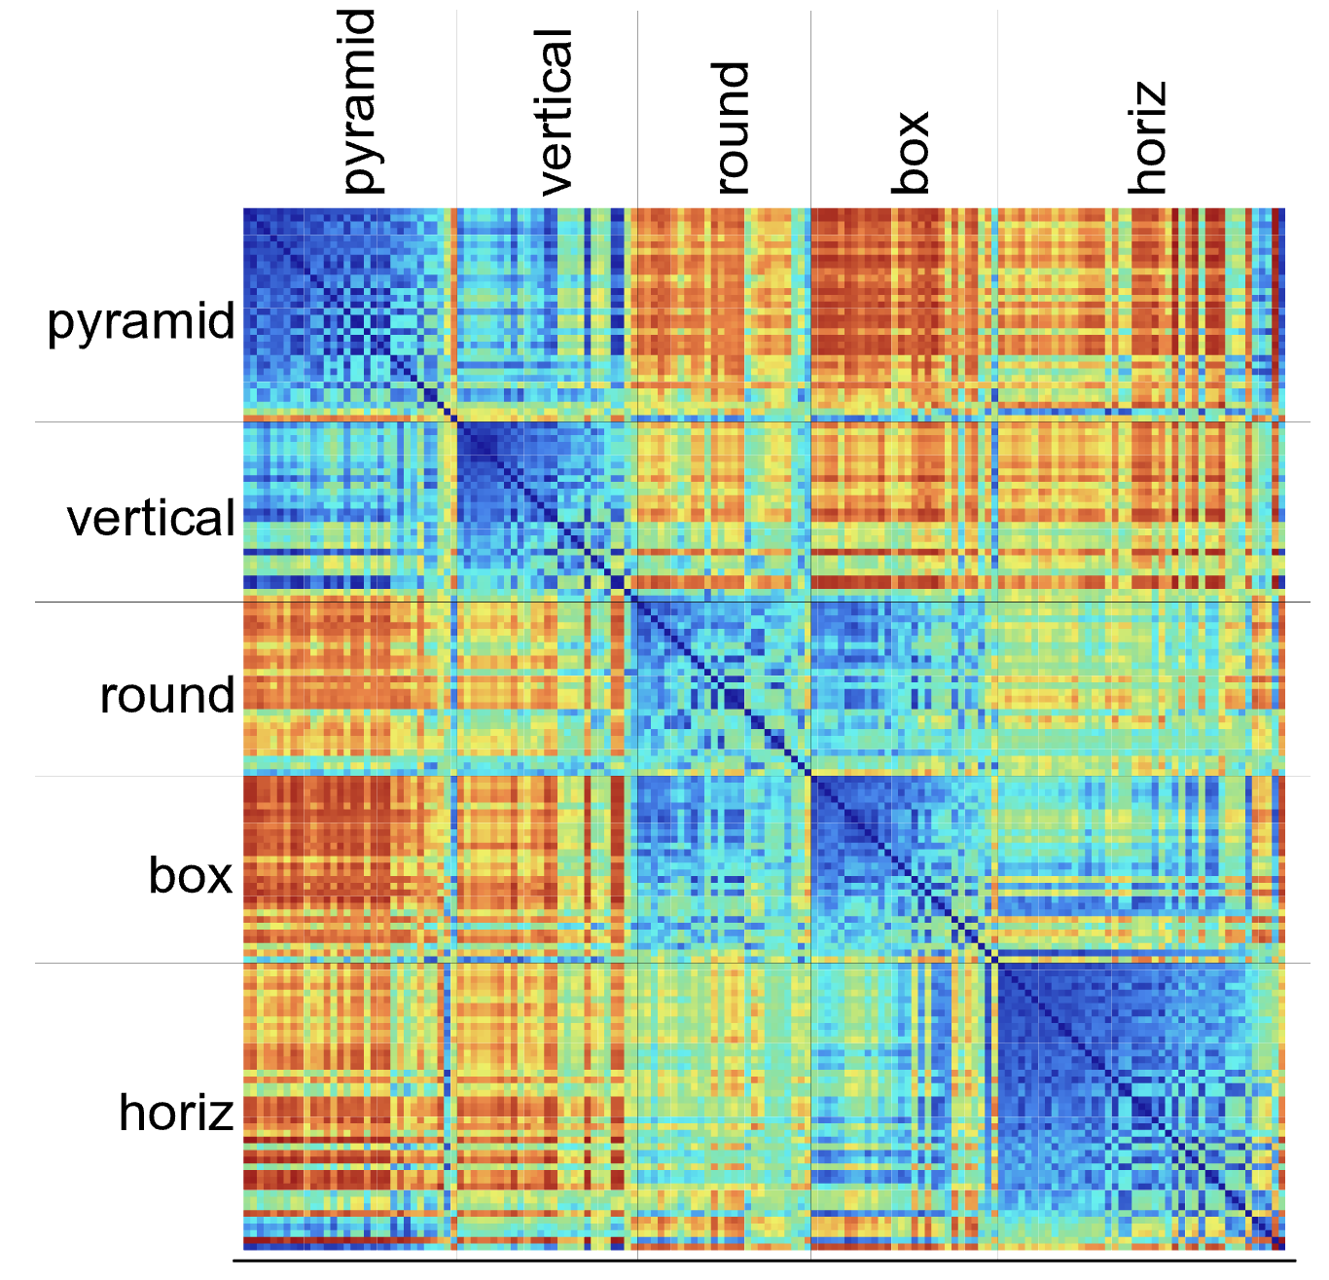
IT Learns Invariant Categories
V1
V4
TE (IT)
Clear enrichment of categorical similarity up the “What” hierarchy: TE is much more “binary” and strongly groups items together.
Completely unsupervised: all prior results depend on extensive training with hand-labeled categorized data. Our model is discovering its categories on its own.
Real brains have much higher dimensional, multi-modal inputs to shape categories..

Slide 13
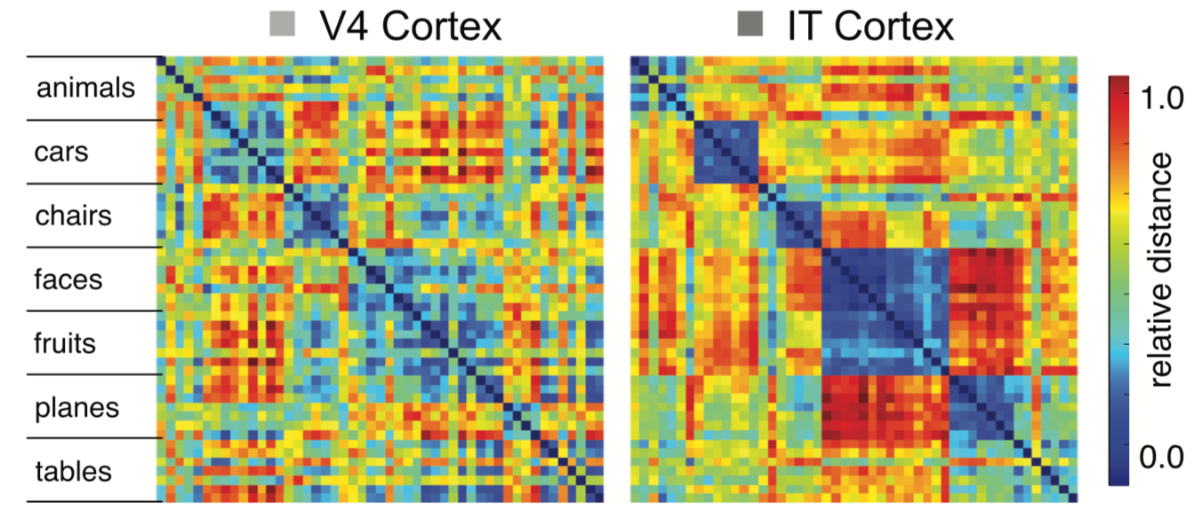
Compares Qualitatively with IT Data
V4
TE (IT)
Model results:
IT forms more consistent, invariant categorical representations
Cadieu et al, 2014 (DiCarlo lab)
Data from macaque

Slide 14
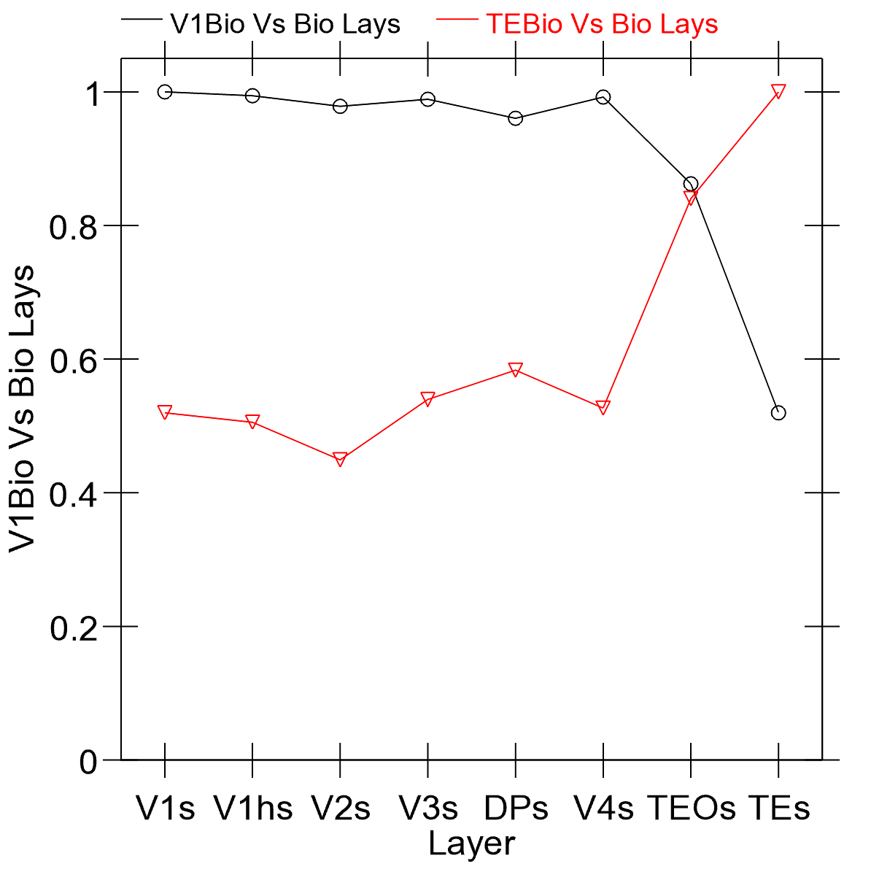
IT != V1
V4
TE (IT)
Cosine of item-wise dist matricies:
* V1 vs. all other layers (guaranteed to be 1 for V1s)
* TE vs all other layers (1 for TEs)
Predictive learning learns whatever it wants, not just what we force it to (with massive labeled datasets…)

Slide 15



Which pair is more Similar? (human data coming soon..)

Slide 16
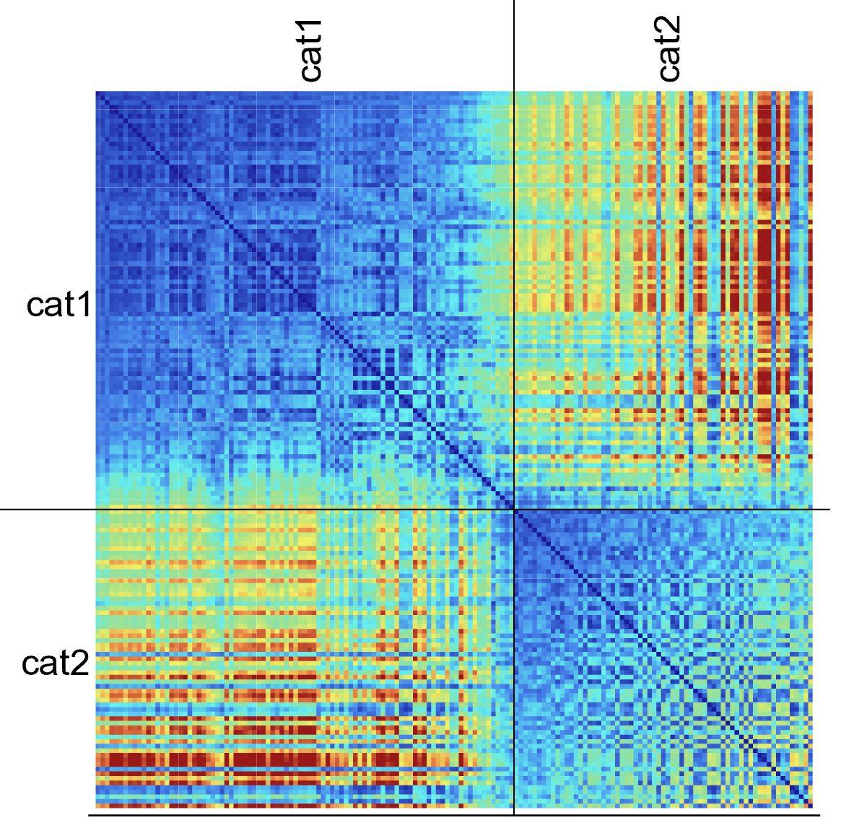
“Bio” vs. Backprop
Backprop version of same architecture creates much broader, essentially binary classification at IT level – doesn’t go much beyond V1 structure

Slide 17
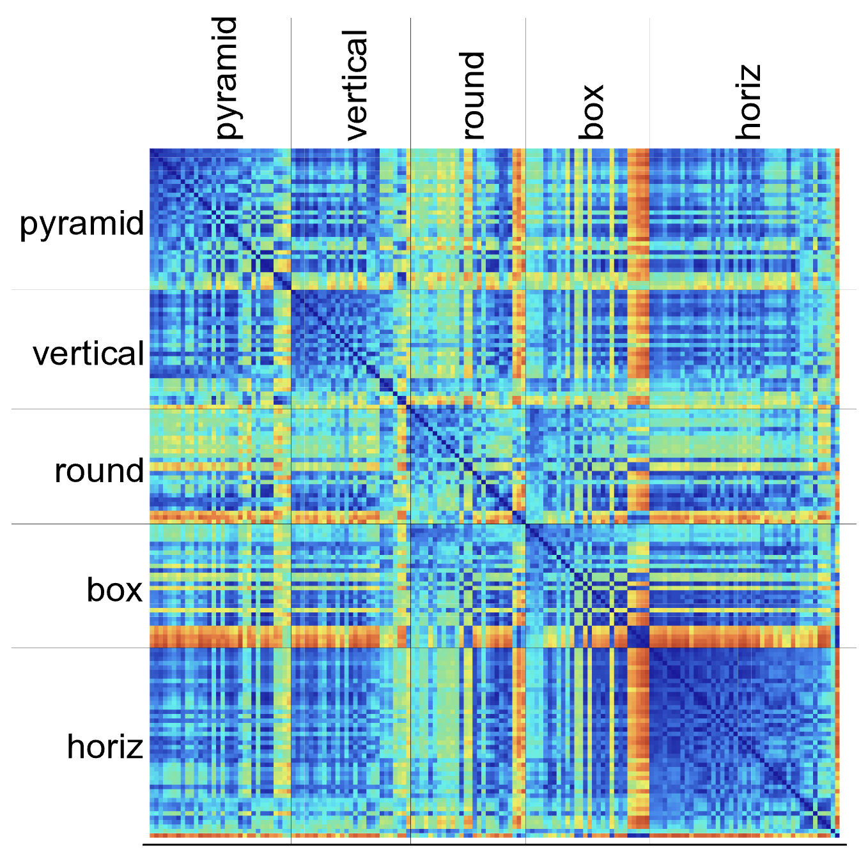
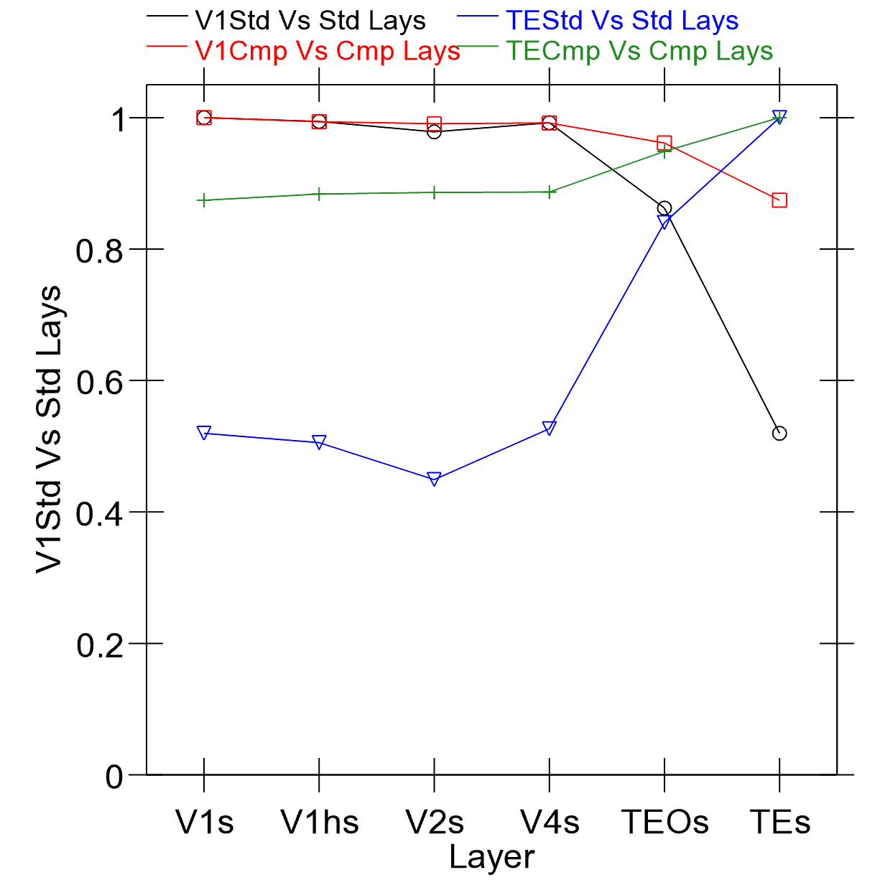
Lesioning Dorsal “Where” Pathway
TE becomes much more like V1 in overall structure
Dorsal factors out “where” predictions and concentrates residual on “what” for IT pathway

Slide 18
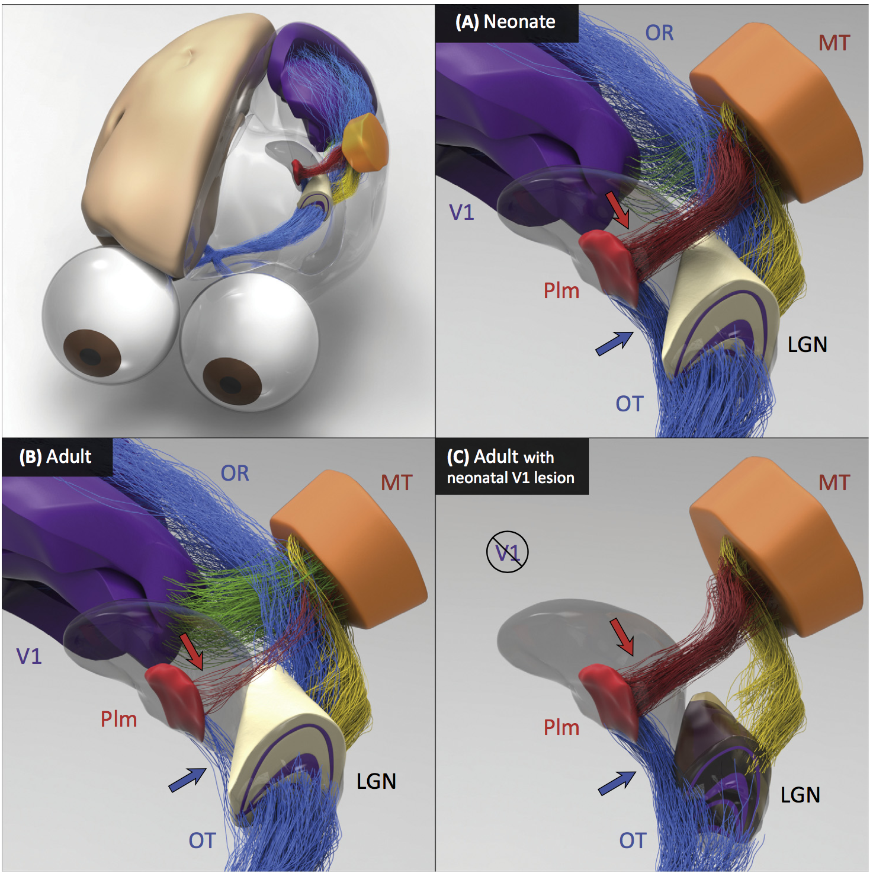
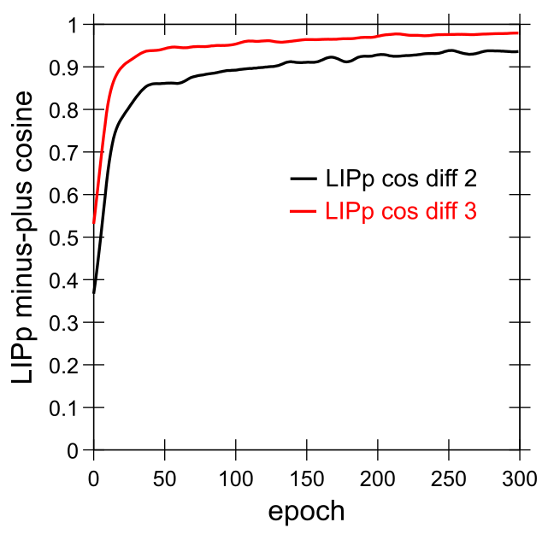
Early What Development
Bridge, Leopold, & Bourne, 2016:
Neonate: direct shortcut from LGN to Pim = Pulvinar which then trains MT and Where pathway
Adult: loses retinal shortcut, has more cortical (V1, etc) drive.
Model: quickly learns Where pathway into LIP, predicting object motion and saccades:

Slide 19
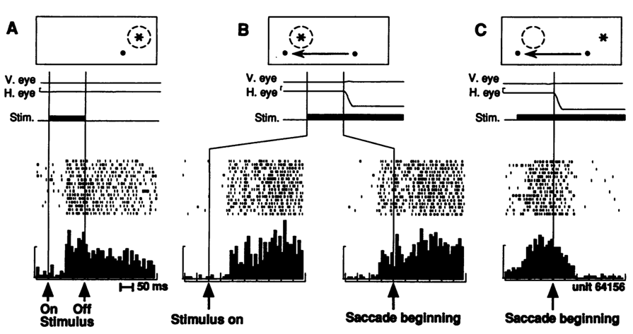
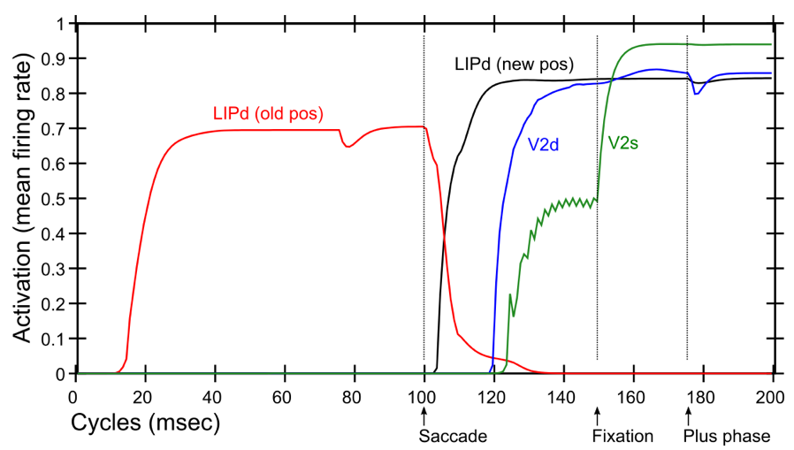
Predictive Remapping
Duhamel et al. (1992):
LIP neurons anticipate effect of saccade, start firing for new location before fixation lands (even before saccade)
Model:
LIPd remaps first at high, abstract level, drives top-down remapping in lower areas – consistent with Cavanagh et al. (2010)

Slide 20
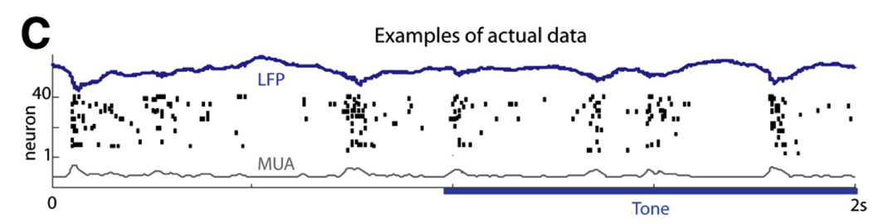
Key Biological Data
Strong, synchronized, low-frequency modulation of cortex (at the alpha frequency).
Specificity of alpha modulation to deep layers & thalamus, not superficial layers.
Nature of deep-layer connectivity to pulvinar: numerous, weaker, plastic pathway (for generating a prediction) and sparse, strong, fixed pathway (for ground truth target).
Synchronization of this strong pathway input with the alpha cycle.
Broad connectivity of pulvinar with different visual pathways (afferent and efferent).
Lack of direct bottom-up superficial projections into the deep layers (would short-circuit prediction), but presence of these projections top-down (beneficial).
Bidirectional (top-down and bottom-up) connectivity between superficial layers.
Early development of the Where (MT, LIP) pathway.
Organization into three separable (yet highly interconnected) visual pathways, particularly a third putative What*Where integration pathway.
(Buffalo et al., 2011; van Kerkoerle et al., 2014; Shipp, 2003; VanRullen & Koch, 2003; Luczak et al., 2013..)

Slide 21

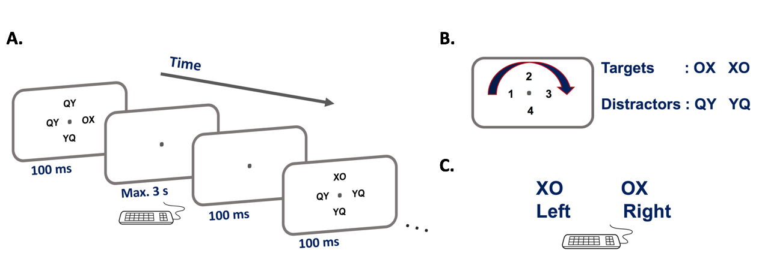
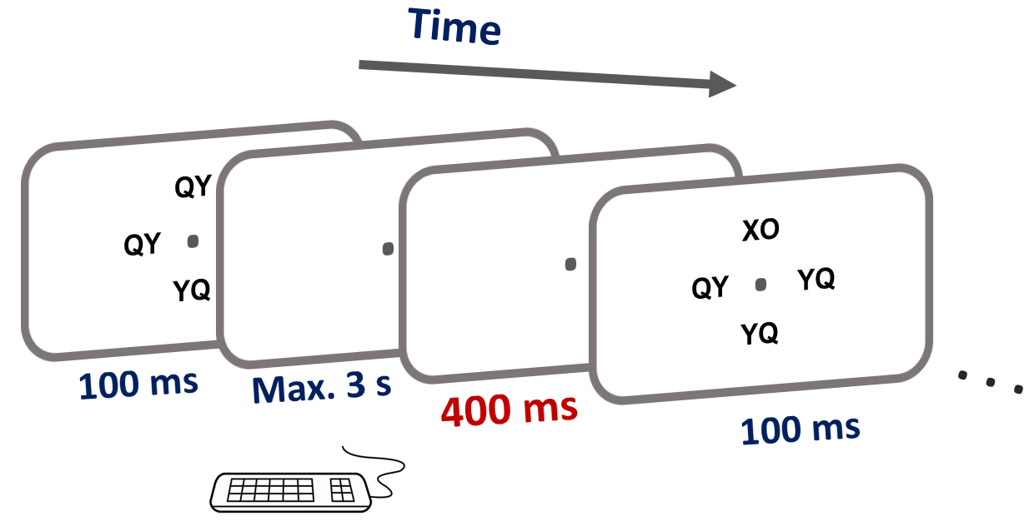
Experimental Test
Maryam Zolfaghar
Seq 1: 42132431
Seq 2: 13423124

Slide 22
Central Hypotheses
Error-driven learning from diff between prediction and what happens next
Prediction – outcome cycle = 100ms = 10hz = alpha
Cortical deep layers drive prediction on Pulvinar
Layer 6CT neurons drive prediction
5IB (alpha burst) from lower layers drive outcome
Error is temporal diff, broadcast fm pulvinar
Local temporal-diff learning throughout cortex

Slide 23
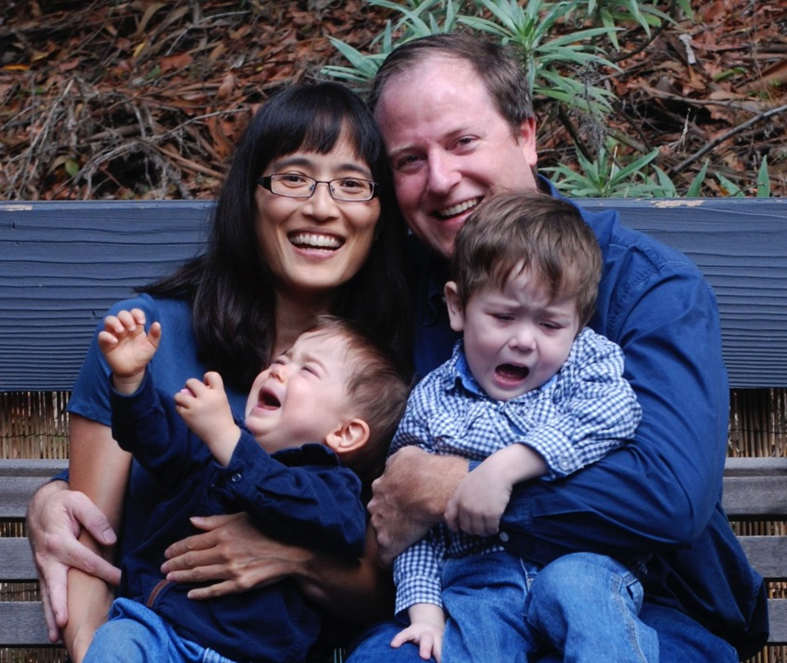
After Visual Learning..
Tantrums!!!
(Monster’s Inc. Scream Power)

Slide 24
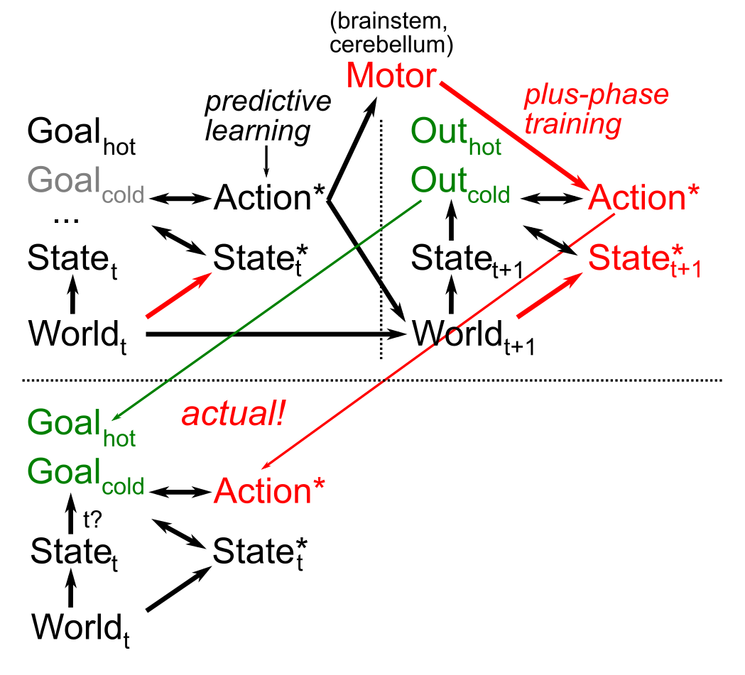
Goals, Motor Modeling
How to turn
action -> outcome
into
desired outcome
-> action?
Not as easy as it might sound..
Key Idea: get action as “target”
Same predictive learning mechanisms applied to forward and inverse sensory-motor learning.

Slide 25
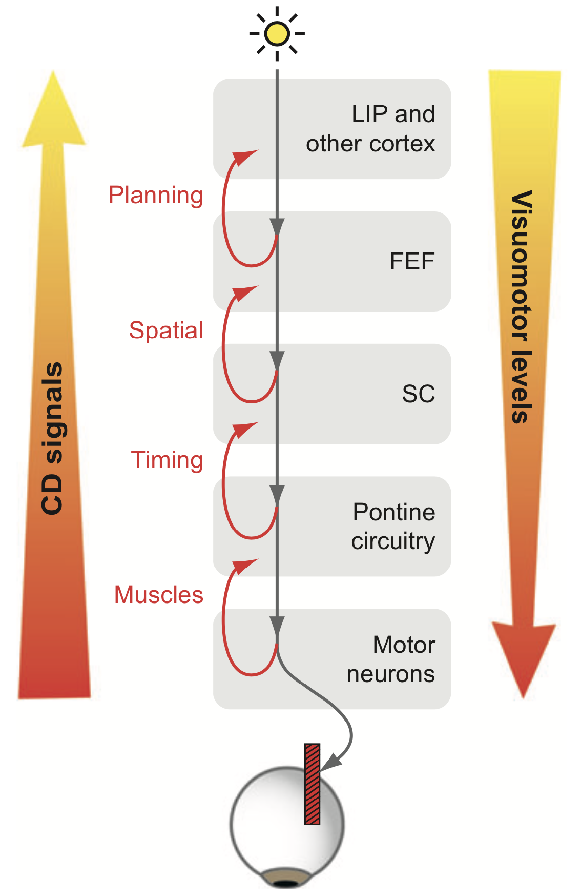
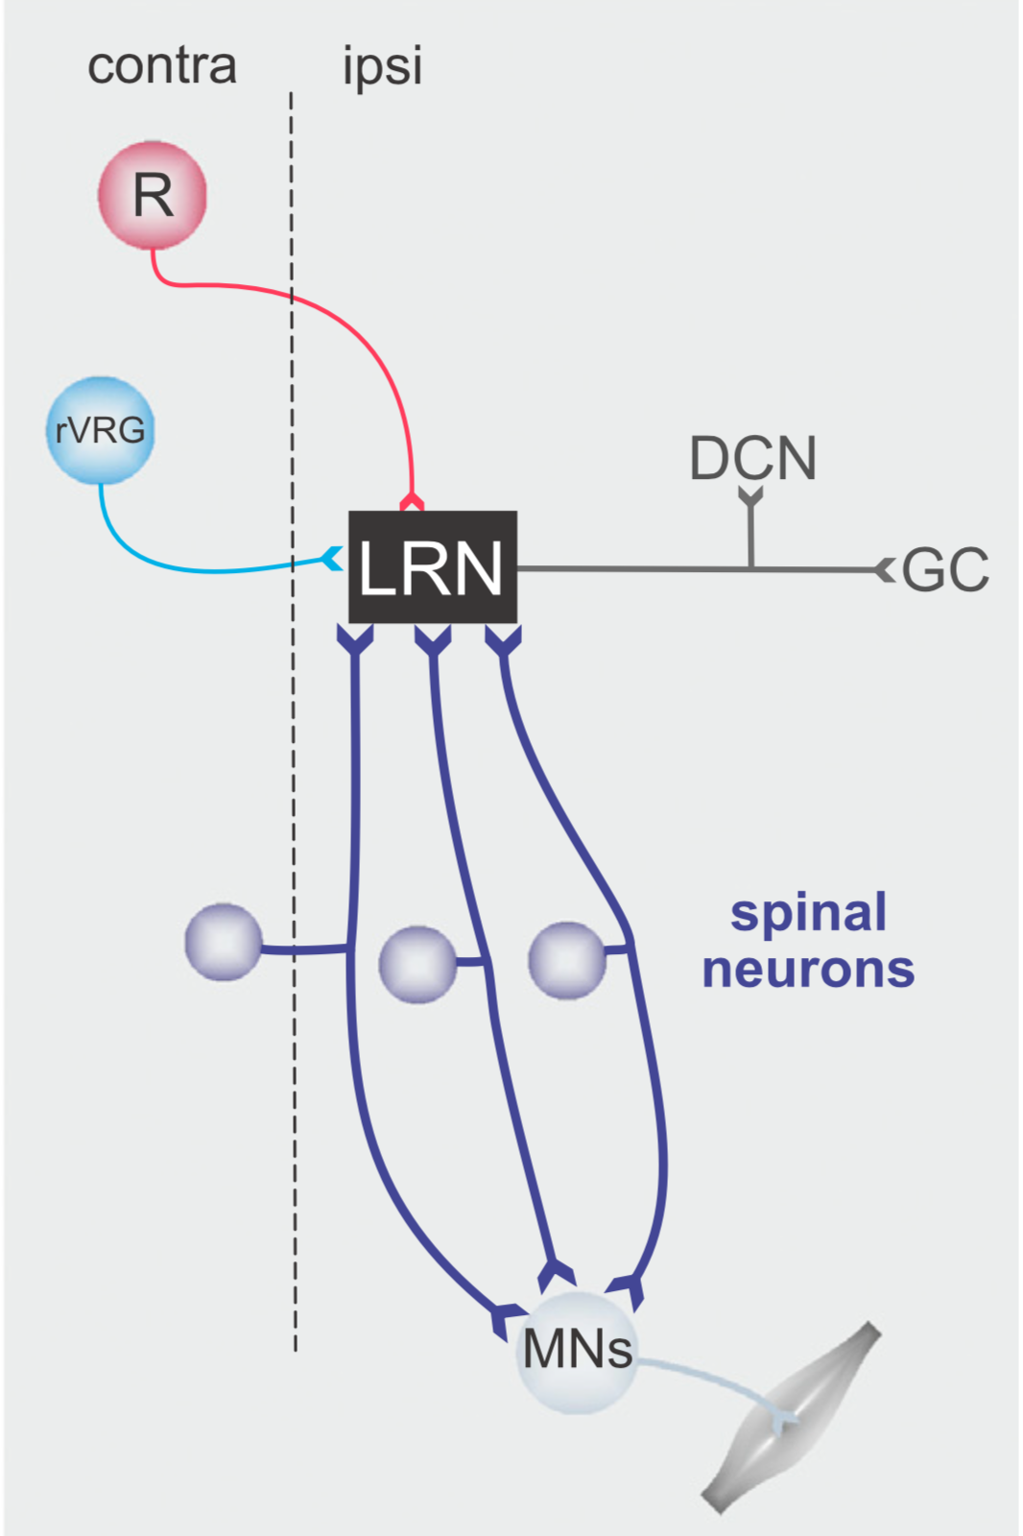
Efferent Copy / Corollary Discharge (Sommer & Wurtz, 2008; Pivetta et al, 2014; Azim et al, 2014)

Slide 26
Key Diffs From Friston / Bayes
Friston et al: errors go up, predictions come down
Us: full activation goes up & down, predictions go to pulvinar via deep cortical layers, errors are *temporal differences*
* Major separation between superficial vs. deep
* Note: no evidence for error coding neurons in brain – yes errors cause more activity compared to expected, but that happens in my model too..
* Emberson et al: A+ = A- -- Friston says A+ ~ 0!

Slide 27
Predictive Models: use model inferred on prior sensory input to predict next sensory input vs.
Generative Models: typically iteratively infer model from current sensory input, and then “predict” that same sensory input.

Slide 28
Conclusions
Peculiar features of connectivity between cortex and thalamus, and interesting developmental wiring changes, support form of predictive learning (many diffs from Friston and others).
Computational model shows that predictive learning from raw visual “movies” self-organizes abstract categorical object representations (based on shape, not texture!)
EEG test of model shows predictive learning signals in theta and alpha bands over visual areas.
Implicit sequence learning / statistical learning => predictive learning!
The future: predictive learning of goals!

Slide 29
Thanks To
CCN Lab
Will Chapman
Tom Hazy
Seth Herd
Kai Krueger
Jessica Mollick
Ananta Nair
John Rohrlich
Jake Russin
Dean Wyatte
Maryam Zolfaghar
Collaborators
Jonathan Cohen
Alex Petrov
Christian Lebiere
Tim Curran
David Sheinberg
Funding
ONR – Hawkins & McKenna

Slide 30
Extras

Slide 31
Invariant Object Recognition is Hard
Different objects in same location share many features
Same object in different locations shares NO features
Hebbian: “fire together = wire together” – exact opposite!

Slide 32
Deep Convolutional Neural Nets
Solve the invariant recognition problem; high performance,
but dependent on huge datasets of hand-labeled images
Baby does not have access to these labels!
(and monkey certainly doesn’t!)

Slide 33
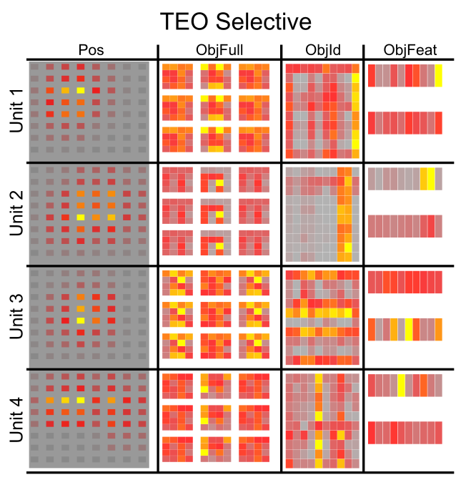
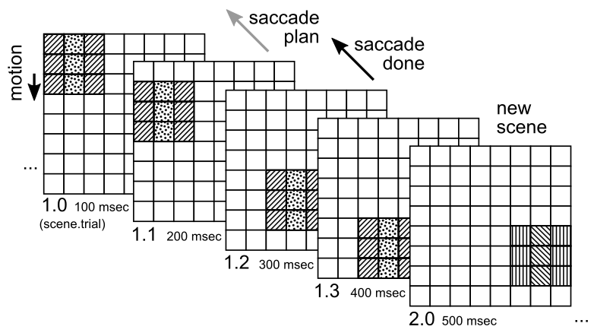
Combinatorial Representations
Objects systematically composed of independent “stripe” features – IT learns these stripes
IT can self-organize low-dimensional, systematic, combinatorial features

Slide 34
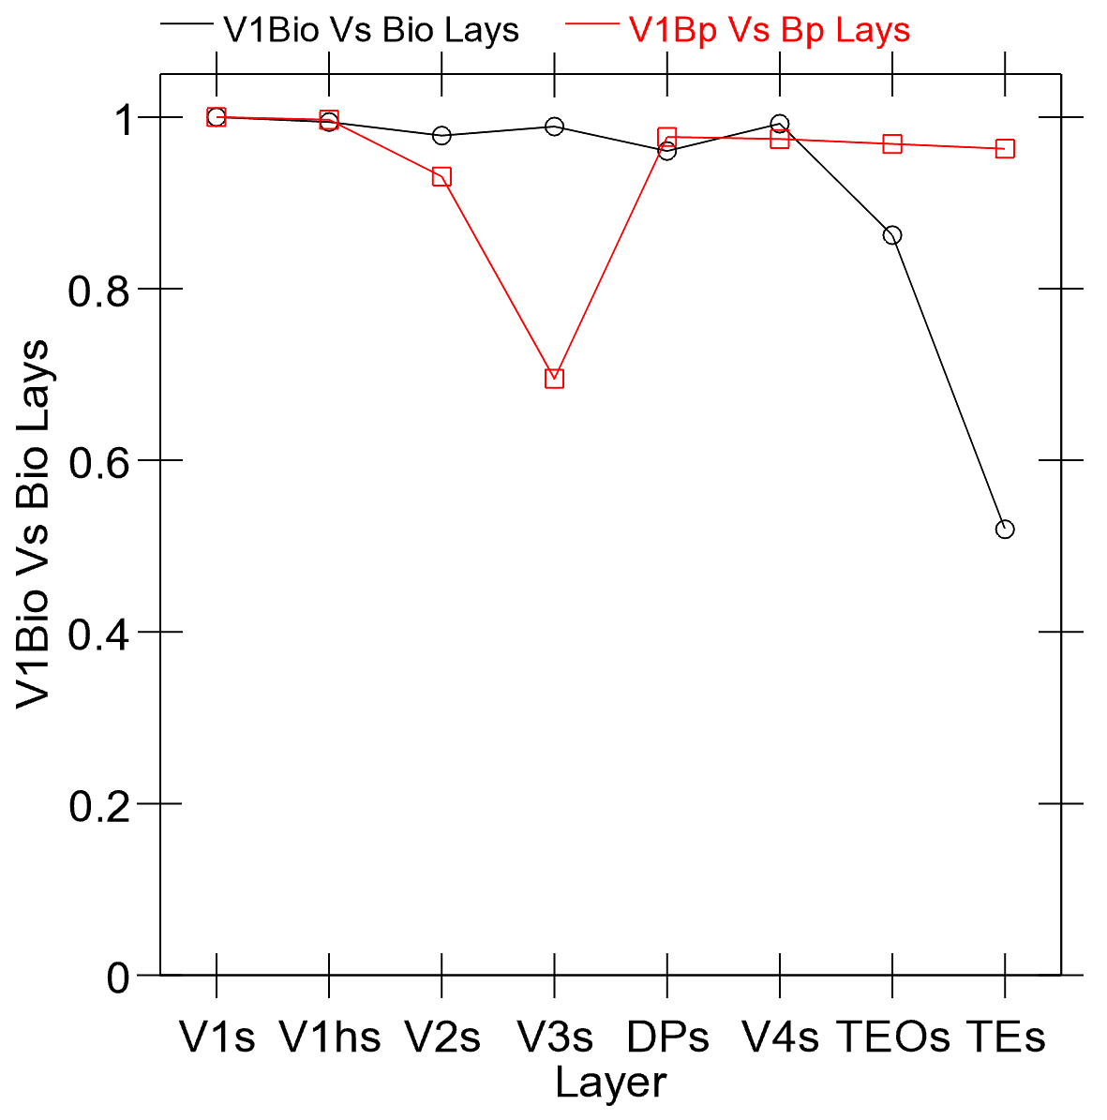
“Bio” vs. Backprop
Cosine of item-wise dist matricies:
* V1 vs. all other layers
* Bp doesn’t go beyond V1 (except in V3 which is key where / dorsal pathway)
Bio model has full bidirectional attractors, inhibitory competition, Hebbian learning – all hard to add to Bp..

Slide 35
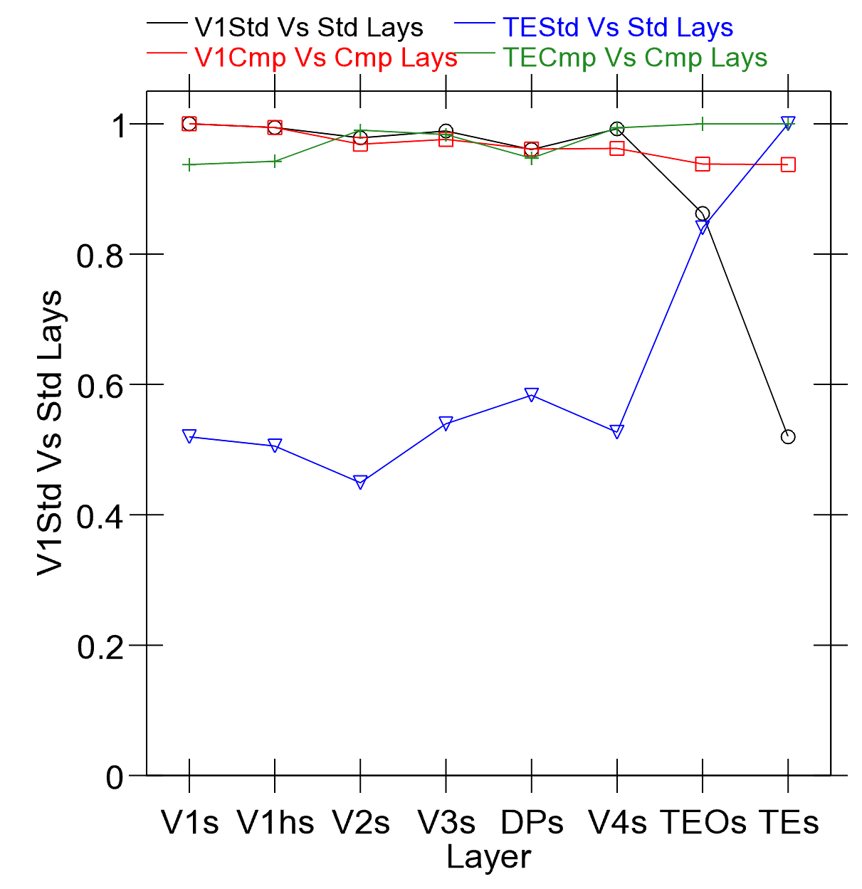
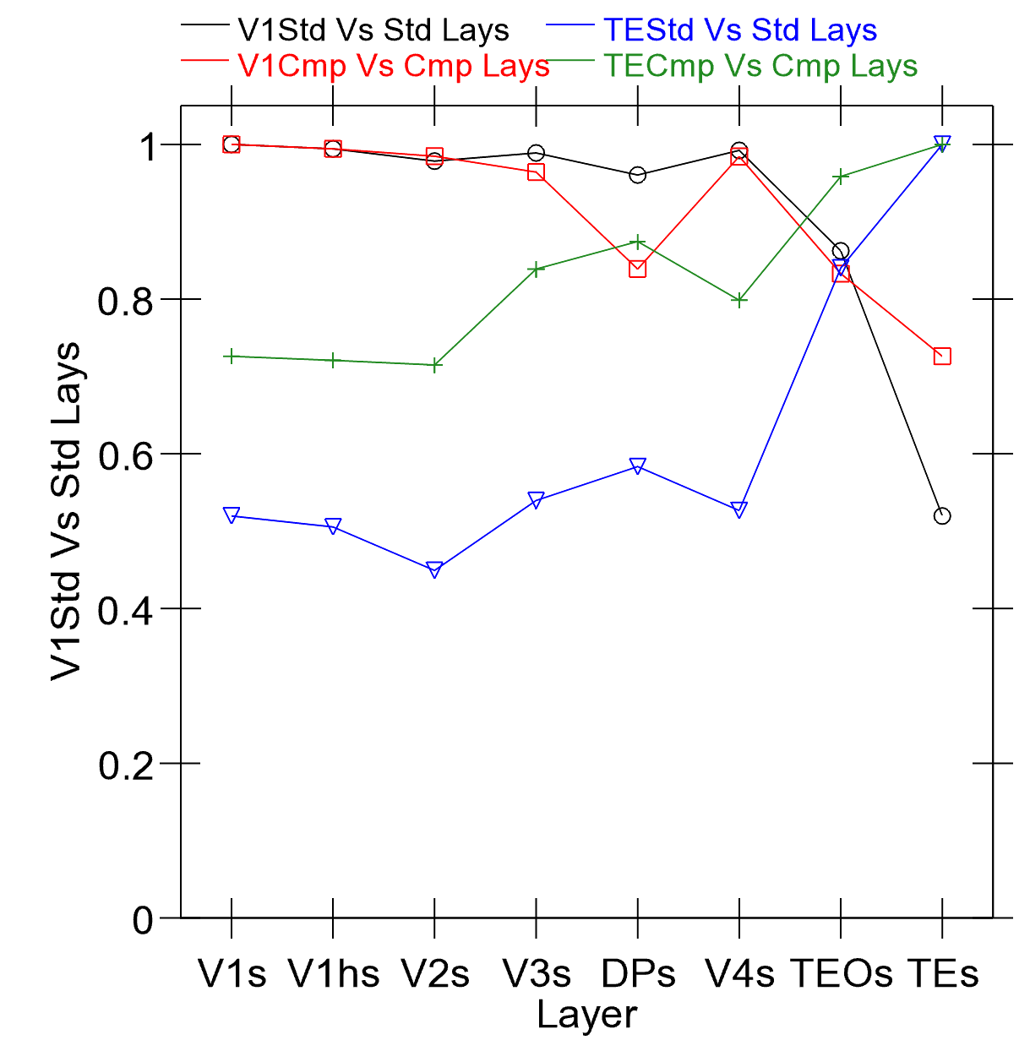
Hebbian and Prediction Effects
Hebbian (+ error driven) is key
Prediction is desirable difficulty in shaping learning – auto-encoder is degenerate (too easy to cheat!)

Slide 36

Predictive Remapping Duhamel, Colby & Goldberg (1992)
LIP neurons anticipate effect of saccade, start firing for new location before fixation lands (even before saccade starts!)

Slide 37
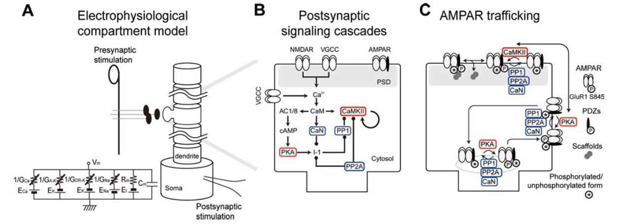
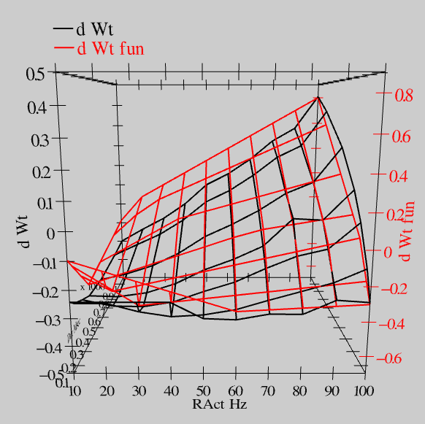
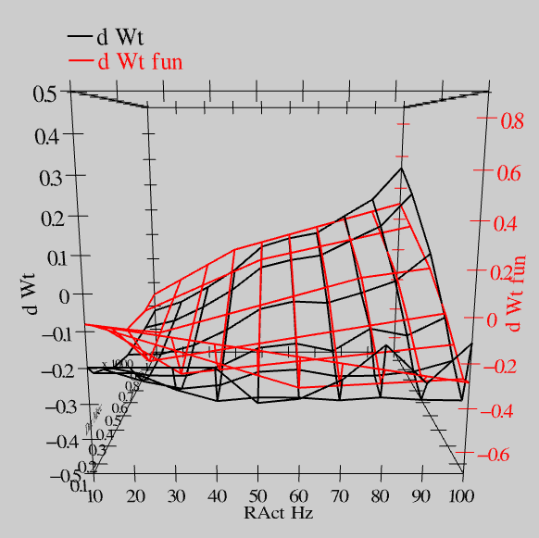
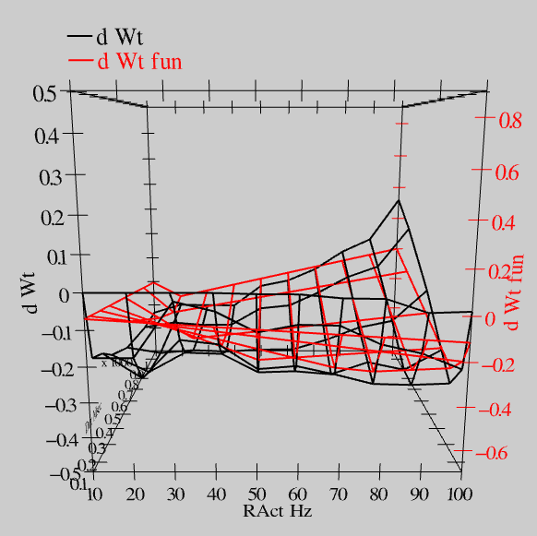
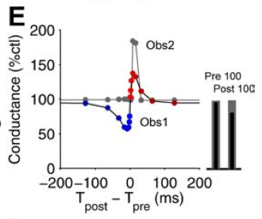
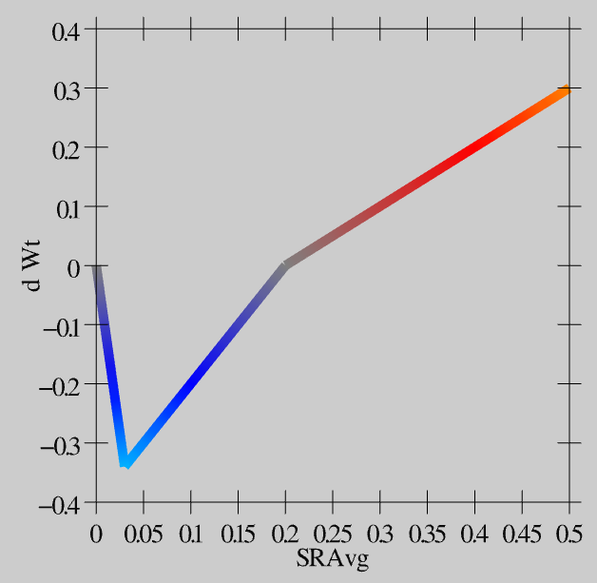
Synaptic Plasticity: XCAL Model (reduction of Urakubo et al, 2008 STDP model)
S = 100Hz
S = 50Hz
S = 20Hz
dW = f(send * recv) =
(spike rate * duration)
r=.894

Slide 38
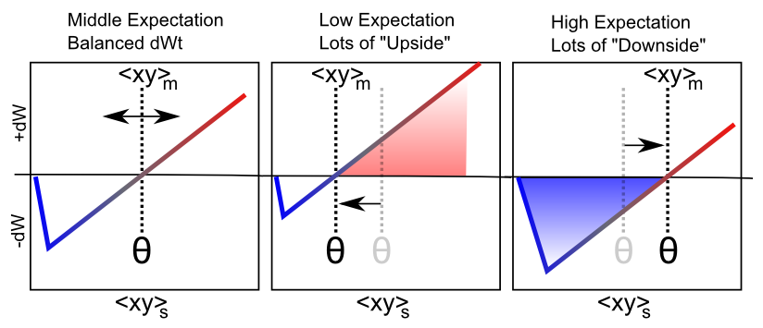
Floating Threshold = Medium Term Synaptic Activity (Error-Driven)
dW = Outcome – Expectation = <xy>_{s} - <xy>_{m}

Slide 39
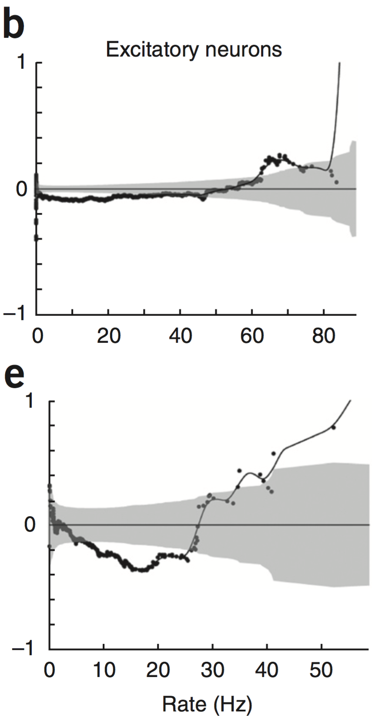
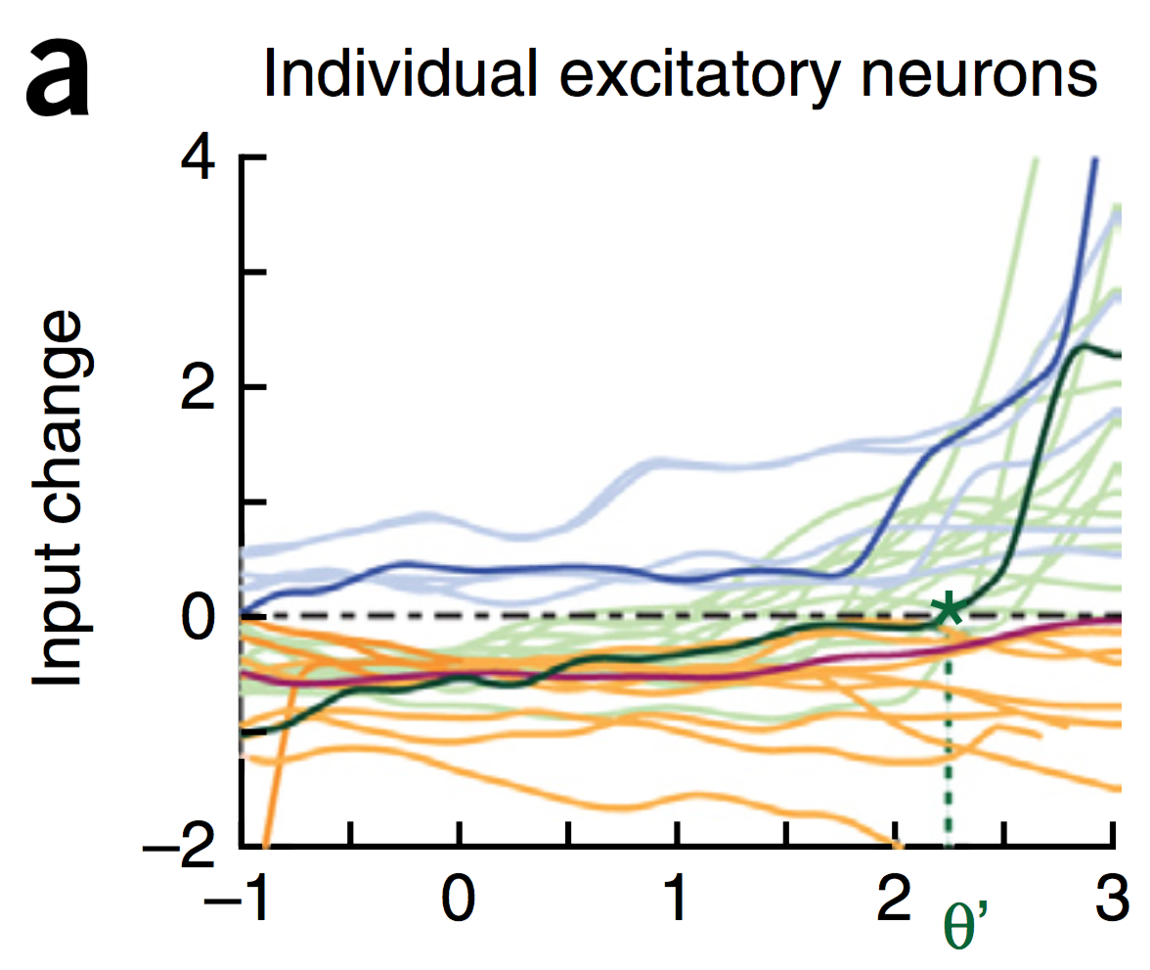
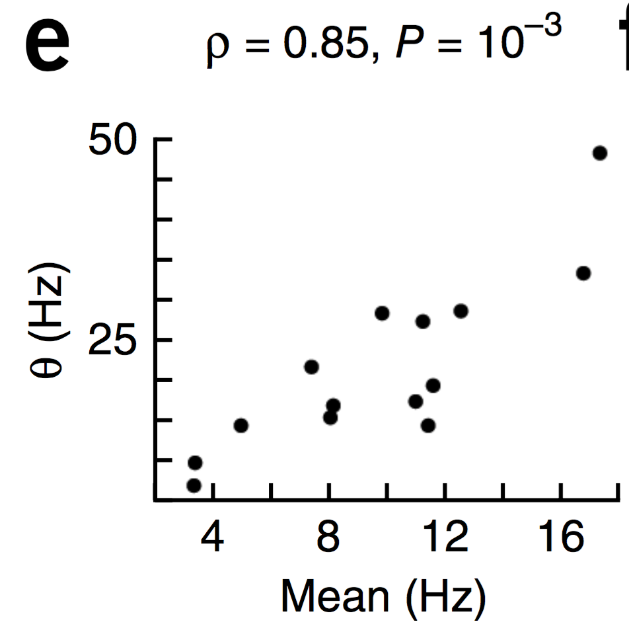
Evidence of Dynamic Thresholds (Lim, McKee, Woloszyn et al., 2015)
b = passive viewing
e = active task
Threshold changes dynamically on a rapid time scale, as a function of short-term activity level!

Slide 40
Catch 22

Slide 41
How can you learn high-level abstraction like “cat” without first learning about fur, paws, texture, color, shapes, edges...?

Slide 42
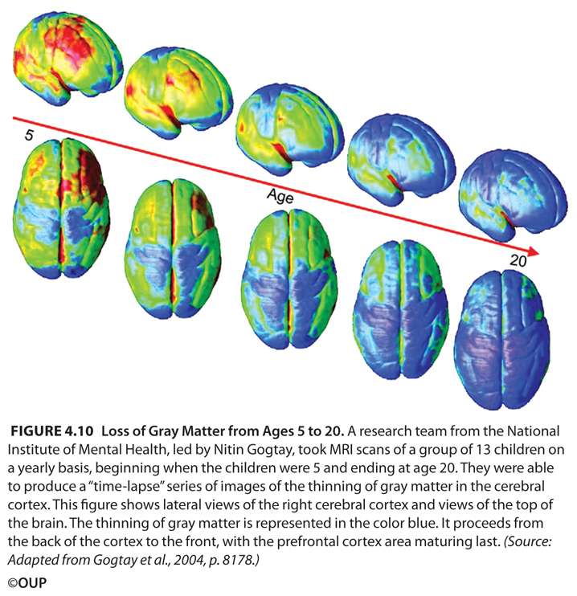
Bottom-up Development
Short-circuit the catch-22:
Progressively learn deeper layers:
each layer learns to encode / predict the one below it

Slide 43
Bottom-up Development
Short-circuit the catch-22:
Progressively learn deeper layers:
each layer learns to encode / predict the one below it

Slide 44
To Make IT Work:
1. Compact high-level representations (What, Where) needed for effective prediction at lowest levels:
Short-cut top-down projections
Earliest possible learning of abstractions
2. Shared “projection screen” where different visual pathways collaborate to create full prediction
Allows full prediction to be solved with separate, specialized pathways
3. Partition prediction error progressively, opportun-istically, to develop separable abstract pathways
Easy to develop abstract Where pathway – do this first!
Residual then concentrates What information
Also need What*Where binding pathway: V3, MT, DP?

Slide 45
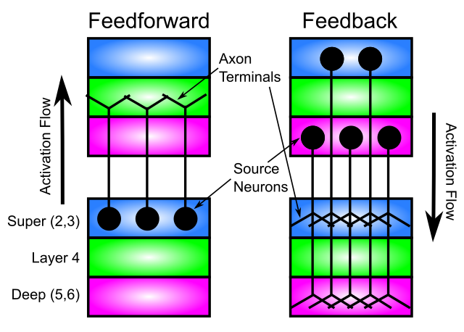
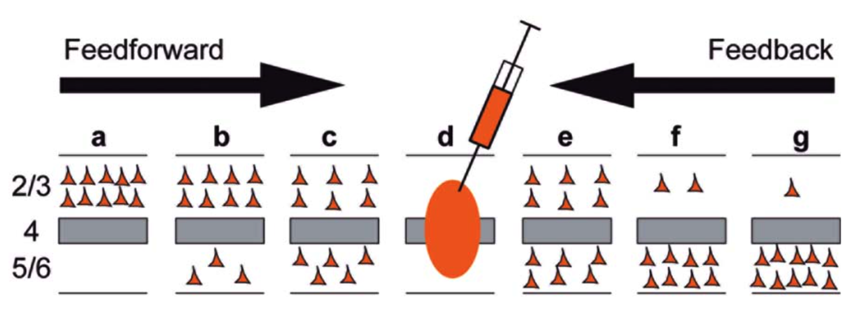
Key Connectivity Constraints
- Critical that feedforward does not project directly to deep layers:
This would short-circuit prediction process
(needs ”eyes closed” to predict)
- Deep feedforward not useful in our model, and rare in brain
- Deep feedback essential – dominates at longer distances

Slide 46
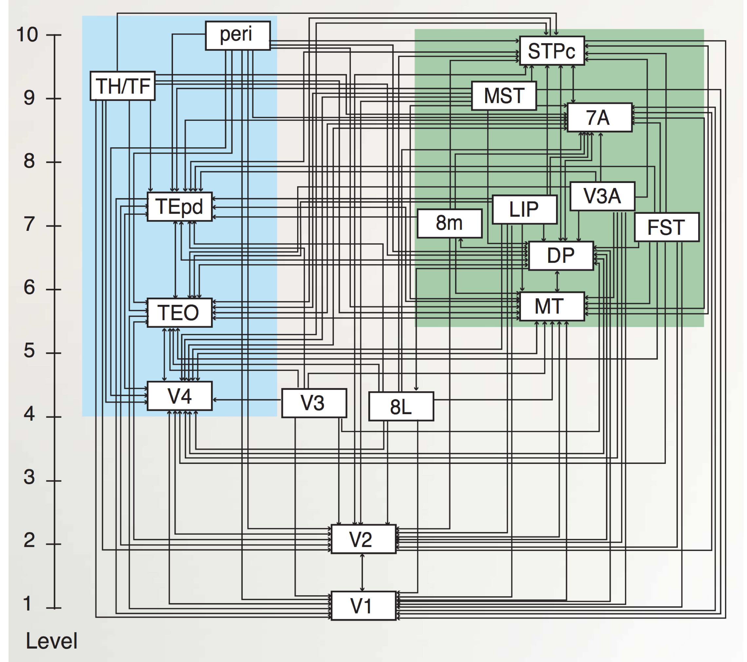
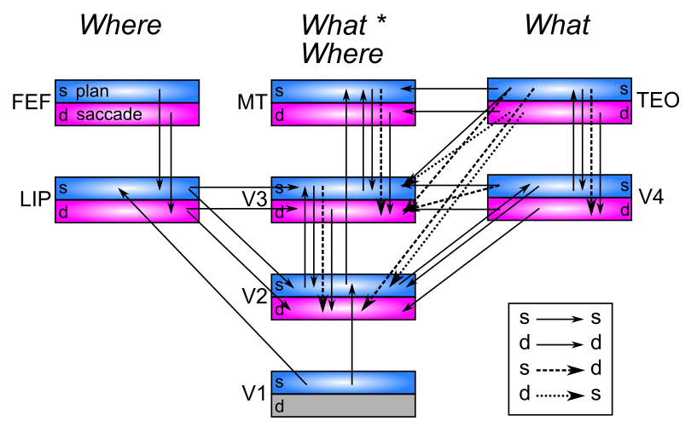
Pathway Interconnectivity
Markov et al, 2014
Extensive interconnectivity between areas – really pathways??
(Freud, Plaut, & Behrmann, 2016; de Haan & Cowey, 2011; Schenk & McIntosh, 2010..)
Dorsal has three pathways (Rizzolatti & Matelli, 2003; Kravitz et al., 2011; Haak & Beckmann, 2017)? MT particularly ambiguous (Milner & Goodale, 2006)

Slide 47
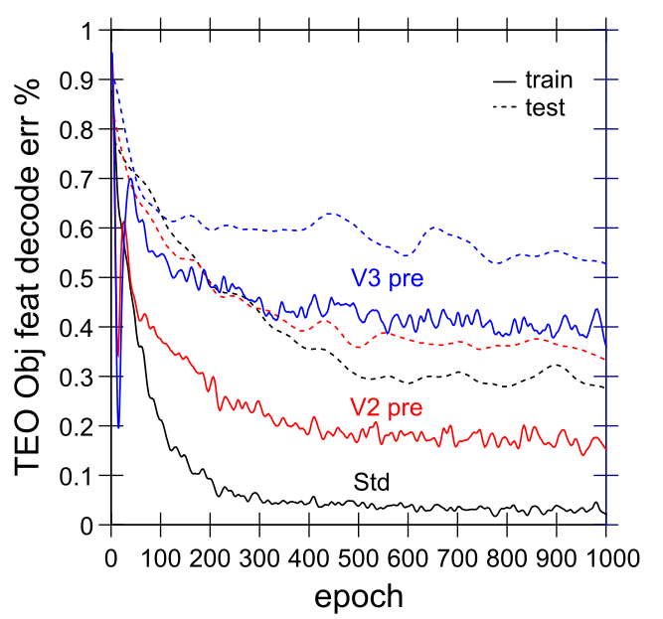
Progressive Bottom-up Not Good
- V2/3 pre = start with weights trained with V2/3 only
- Higher pretraining = worse performance!
- Need abstract, high-level areas shaping learning from the start

Slide 48
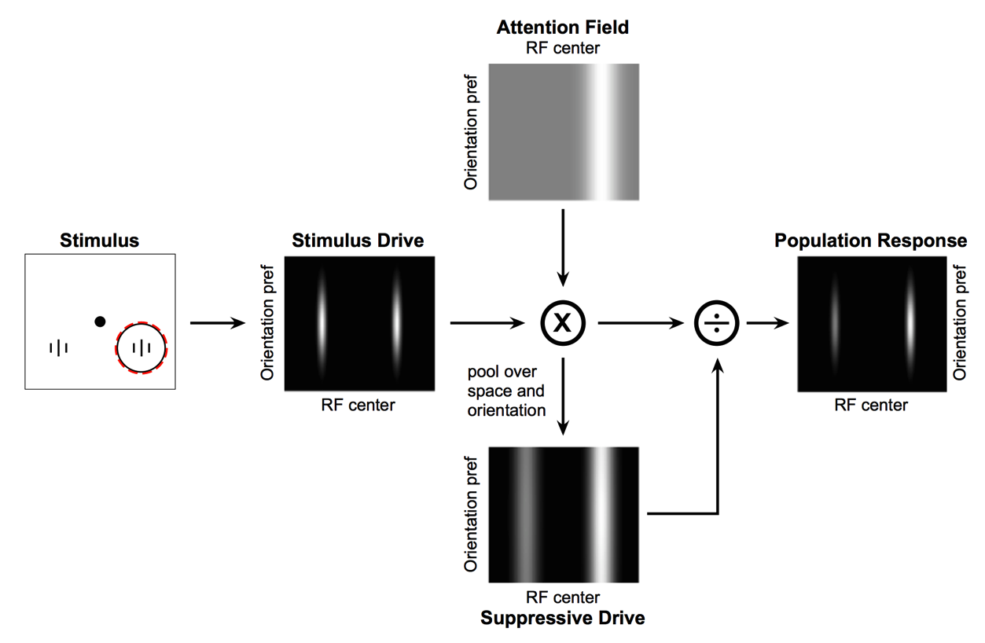
Deep Attentional Dynamics (Reynolds & Heeger, 2009; Grossberg, 1999)
Top-down deep layer
Attentional drive
Inputs to Layer 4
Layer 6 gain control
(Olsen, Bortone et al)

Slide 49
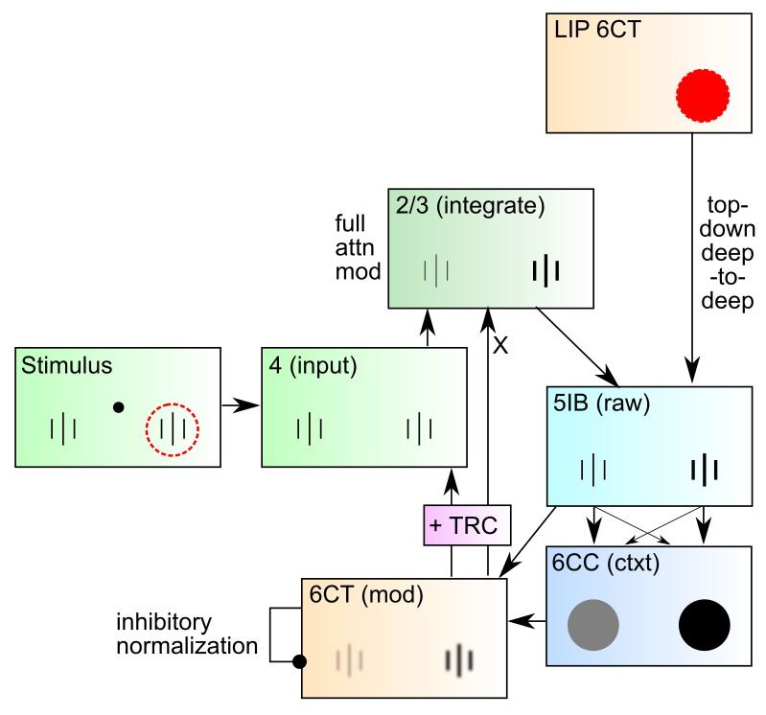
DeepLeabra Attentional Dynamics

Slide 50


Attentional Dynamics Results

Slide 51

Bidirectional Connections Carry Error Gradients (GeneRec; O’Reilly, 1996)
dW = x⁺y⁺ - x⁻y⁻
(Midpoint integration + symmetry = Contrastive Hebbian = DBM)

Slide 52

Activation Diffs Implicitly Compute Derivatives (GeneRec; O’Reilly, 1996)
Free to use arbitrarily complex activation functions!

Slide 53

Key Prediction: Full Processing Requires 2 Alpha Cycles
First alpha cycle = bottom-up processing of new input without established prediction
Second cycle = deep-layer prediction (generative model of scene) contrasts with second wave of bottom-up processing, differences drive learning
Predictions: saccade duration = 2 alpha cycles; novel vs. familiar emerges in 2nd alpha cycle

Slide 54


Data from David Sheinberg, Tim Curran’s labs Consistent with predictions from model
Super
Layers
(2 cyc,
nov vs
fam 2nd only)
Deep
Layers
(2nd cyc
only)
Left: super vs. deep local field potential in monkey IT cortex, showing 2 alpha-frequency waves in superficial layers, 1 in deep layers, with familiar vs. novel differences emerging in 2nd alpha cycle.
Right: fixation duration for humans in free viewing of complex scenes, with strong 200msec peak predicted by model (2 alpha cycles)

Slide 55

Saccade Resets Alpha (Zolfaghar, Devillez, Curran et al, in prep)
fixation onset
synchronized alpha

Slide 56






Simultaneous V4 and IT Recording (Guan & Sheinberg, in prep)
Spike waveforms

Slide 57
IT Encodes Familiarity First
Despite having slower onset, IT encodes familiarity before V4
} novel
} familiar
PSTH
significance
onset
offset

